Slide 1

Pale Blue Dot
Kristy Nguyen
Thomas Bryant
CS469 Digital Image Processing Project
Spring 2024

Slide 2
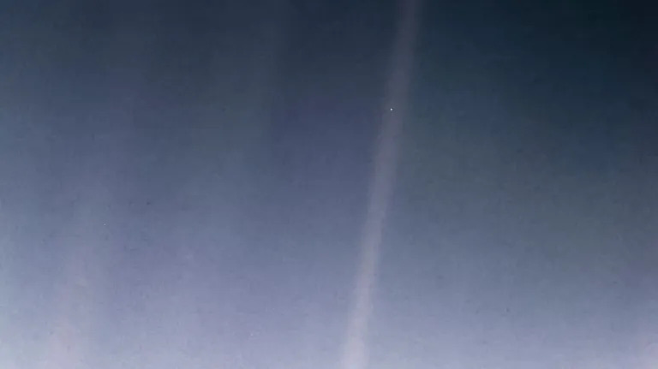
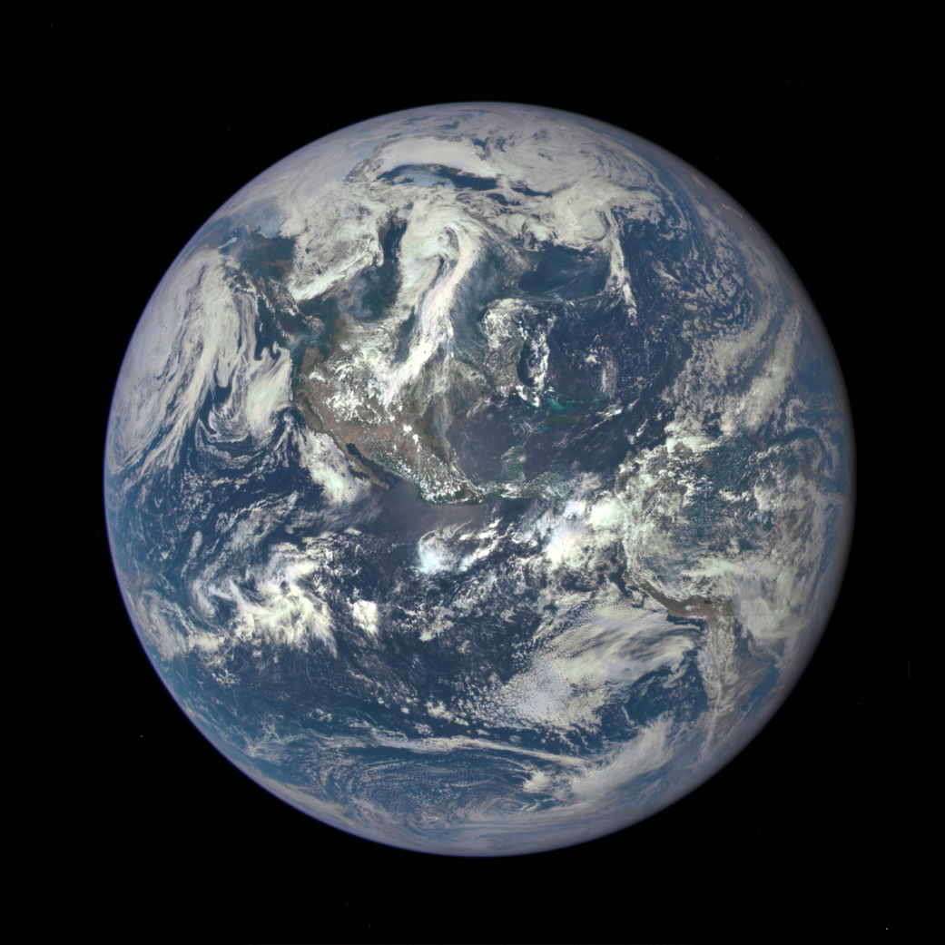

Project Objective
Our goal was to create a video showcasing the pale blue dot expanding into a high-resolution image of Earth. We achieved this by gradually shrinking the Earth image while shifting it, until it became a single pixel at the location of the 'Pale Blue Dot'. Finally, we displayed these frames in reverse order for the desired effect.

Slide 3
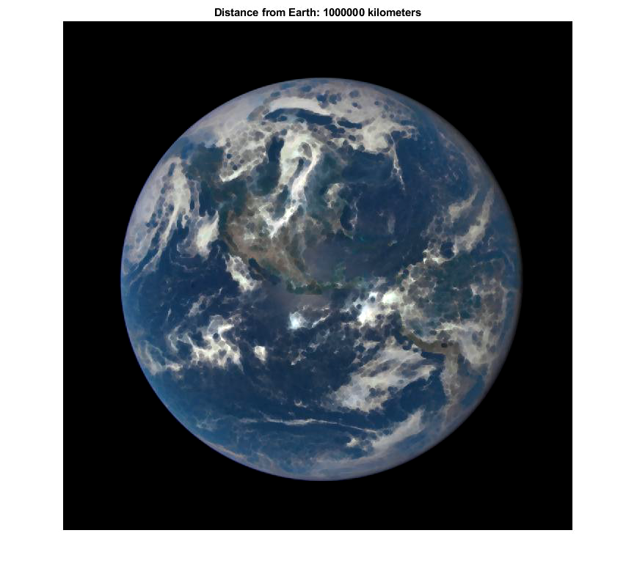
Initial Solution and Difficulty
Initially, we used Erosion with a spherical structural element and applied sharpening as necessary.
We calculated the distance of each frame based on the average distances between images.
However, our initial approach eroded the planet's details prematurely rather than effectively shrinking it.

Slide 4
Refactoring using imresize
We utilized MATLAB's 'imresize' function, employing bilinear interpolation for image resizing. Bilinear interpolation averages the values of the four nearest pixels to estimate the new pixel value.
To enhance image quality, we enabled anti-aliasing in 'imresize' and applied a Gaussian filter with 'imsharpen' using unsharp masking.
For video creation, we used 'VideoWriter' to store frames and then reversed the process for the desired raw video.
Lastly, we padded the video with initial and final frames to sync with the audio of the 'Pale Blue Dot' speech.

Slide 5
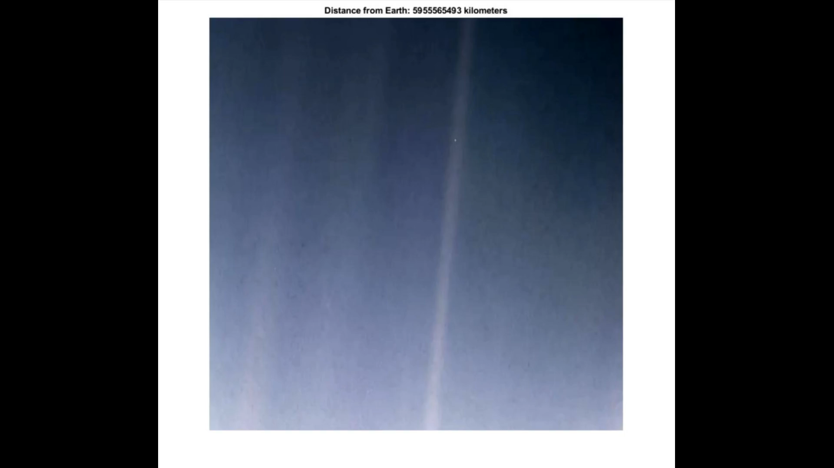
Final Product

